Slide 1
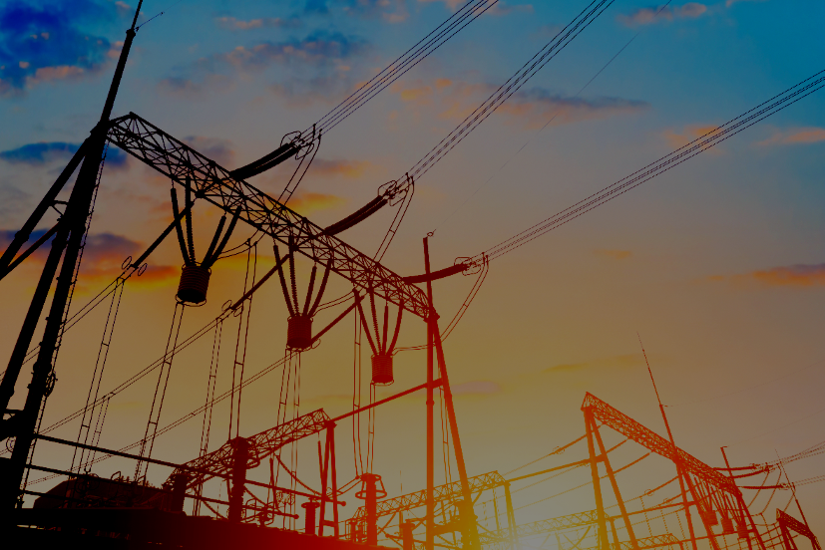
USAID’s Urja Nepal Program
Photo credit : Deloitte
Insurance for South Asian Utilities, experience sharing
This document is made possible by the support of the American people through the United States Agency for International Development (USAID). The contents are the sole responsibility of Deloitte Consulting LLP and do not necessarily reflect the views of USAID or the United States Government.

Slide 2




Growth of Hydro Power in South Asia; significant opportunity for Insurance buy-in
High capacity addition targets for Hydro in South Asian countries like India, Nepal and Bhutan
Hydro growth Target in India
Hydro growth Target in Nepal
Hydro growth Target in Bhutan
Figures in MW
+52%
+196%
+200%
+49%
+974%
+330%
For Nepal:
Historically, insurance sector has remained below 2% of country’s GDP indicating significant opportunity for growth
However, based on historical trend (FY 17 to FY 21), gross written premium is estimated to increase at a CAGR of ~13%** for insurance sector
With possible realization of economically feasible hydro potential, contribution of hydro sector to growth of insurance sector as well as overall country’s economy can increase to as high as ~10X times of current value
For Bhutan, hydro sector contributes to 14% of Bhutan’s GDP and 26% of total Bhutan’s revenue), thereby forming one of the main pillars supporting Bhutan’s economy
With significant quantum of hydro capacity addition expected in the near future for South Asian countries and due to the substantial investments involved, appropriate insurance protection would be critical to safeguard the sector and the economy at large
Source: CEA, Deloitte Research
*Note: For Nepal, out of 83 GW technically feasible potential, ~42 GW is economically feasible
**As per Globaldata

Slide 3
Energy Mix Trend in South Asian Countries
In South Asia as a whole, thermal generation is dominant in terms of scale; significant potential for hydro to balance mix
Energy Mix in India (GW, %)
Energy Mix in Bangladesh (GW, %)
Energy Mix in Nepal (GW, %)
Energy Mix in Bhutan (GW, %)
As countries are taking considerable steps for greening their energy portfolio and diversifying into cleaner and sustainable generation, for countries like India and Bangladesh, where thermal generation dominates the energy mix, hydro would play a key role towards increasing energy security as well as contributing towards achievement of major NDC targets
With many inherent advantages of hydro as detailed in subsequent section, especially the fact that hydro power is green stable energy with quick start ability, and also considering the significantly high potential it has in countries like India, Nepal and Bhutan, importance of inculcation of hydro in the energy mix to improve overall energy security in South Asia finds significant merit.

Slide 4
Why Hydro?
Inherent benefits as a clean supply source with grid stabilizing affect makes Hydro essential for the energy mix of a country
Sustainable Low Carbon Energy Source
Hydro energy can fulfil clean energy targets. While many countries are striving for achievement of net-zero, hydro can be extremely beneficial through its scale and stable output power
Reduce flooding and manage water resources for the country
Hydropower projects can reduce impact of environmental damages and assist in conserving precious water resources for the country
Clean Energy Source
A
Quick Start / Black Start Capability
Hydropower’s quick-start capability and the capability to run at a zero load. When loads increase, additional power can be delivered rapidly to the system in order to meet demand
Regulation and Frequency Response
Hydro plants can assist in maintaining the frequency through continuous modulation of active power and to address moment-to moment fluctuations in system power requirements. Their fast response ability makes it especially valuable in covering steep load gradients (ramp rates) through its fast load-following.
Voltage Support
Hydropower plants have the ability to control reactive power, thereby ensuring that power will flow from generation to load. They also contribute to maintain voltage by injecting or absorbing reactive power to the system/Grid.
Spinning Reserve
Hydropower plants can provide spinning reserve – additional power supply that can be made available to the transmission system within a few seconds in case of unexpected load changes in the grid.
Ancillary Services
B
Further, South Asian countries especially like India, Nepal and Bhutan are naturally endowed in terms of Hydro power generation potential

Slide 5
Challenges in Hydro Power Sector
Major factors like risks of natural disasters along with financing issues and/or R&R can severely impact hydro projects
Slippage Issues as witnessed in India
Stage-wise Challenges in Hydro
Reason for Slippages in 12th Plan Hydro Projects
Figures in MW
Construction Phase
Operating Phase
Strike, Riots & Civil Commotion (R&R*)
Delay in achievement of Financial Closure
Debris removal
Project cost escalation
Vendor delays, contract defaults, delay in procurement
Fire and named perils or Property All Risks
Machinery Breakdown
Business Interruption
Third Party Liability
Delay in revenue realization
Regulatory challenges associated with tariff
Perpetual Risks
Climate Change risks
Earthquakes
Floods
Glacial Lake Outburst Flood (GLOF)
Delay in Clearance / Inv. Decision / Financial Closure
Delay in Award of Works
Court Case / Litigation
Geological Surprises
Natural Calamity
Delay in DPR Preparation / MoU Issues
R&R Issues
Delay in MoEF Clearance
Total Documented Reason for Delay
*Rehabilitation and Resettlement
Any of the issues above whether stand-alone or in combination thereof can potentially disrupt the projects to severe degree
For a high capital-intensive sector like hydro which is prone to such threats, insurance coverage thus becomes extremely important; however, degree of insurance coverage and pricing of such insurance products would also have to be done in such a way so as to achieve balance and make the arrangement viable for both insurer and insured parties

Slide 6
Key Identified Challenges faced by Hydro Power Plants with respect to Insurance
Challenges from the perspective of Hydro Developers
Environmental Risks: Hydro power plants are vulnerable to environmental risks, including floods, landslides, and seismic activities, requiring specialized coverage to address the unique challenges posed by these factors
01
02
Availability of Reinsurance: Hydro companies face limitations in securing reinsurance to cover catastrophic events, affecting their ability to transfer risk effectively
Construction Risk: The company/power plants generally relies on insurance coverage secured by contractors to protect against damage and loss during the construction phase of its hydroelectric projects
03
Project Complexity: The complexity of hydroelectric projects, including large-scale infrastructure, intricate machinery, and unique operational risks, poses challenges in accurately assessing and underwriting insurance coverage.
04
05
High Premium Costs: Hydro companies often face high premium costs due to the unique risks associated with hydroelectric projects, including construction, operational, and environmental risks
06
Limited Coverage Options: Finding comprehensive coverage that addresses all the specific risks of hydro power plants can be challenging, leading to gaps in coverage.

Slide 7
Challenges Faced by Nepal’s HPP Insurance Market
Challenges from the perspective of Insurance players/ market
Low Insurance Education/ Inherent resistance
Insurance is often seen as an impractical investment because premiums are paid annually, while indemnities are infrequent.
Insurance premium/price setting
Tariffs are heavily regulated in Nepal which does not follow a cost-plus model; therefore, not market driven. Thus, optimum price discovery of insurance products has been historically a challenge
Major Challenges faced by Insurance Market
Low Non-Life Insurance Penetration
In developing countries like Nepal and Bhutan, insurance penetration has historically been low
Regulatory Impediments
As an example, Reinsurance firms must comply with Insurance Board regulations, which require them to retain profits for five years and adhere to investment limits like non-life insurers. Such rules, potentially discourage market entry.
Limited Access to Capital Markets/ Investment Portfolio Restrictions
Direct access to capital markets by domestic insurance companies and governments in Nepal is still evolving; The insurance securitization market is still underdeveloped
Limited Technical Capacity
In Nepal, risk modeling for HPPs demands expertise in areas like statistics, seismology, and meteorology inter alia. Developing such capabilities in-house is costly and time-consuming, likely exceeding the resources of insurers in developing markets

Slide 8
Types of Insurance for Hydro Power Projects in Nepal
Different Insurance options available depending on phase of project life
During Construction Phase
During Operational Phase
Contractor’s all Risk Insurance
Erection All risk Insurance
Fire and Allied Perils Insurance
Business Interruption Insurance (Loss of Profit Insurance)
Types of Insurance
Types of Insurance
Professional Indemnity Insurance
Contractor’s plant and machinery insurance
Transit Insurance
Machinery Breakdown Insurance
Note: Policy products described in detail in Annexure

Slide 9
Types of Insurance for Infrastructure Projects in India
Key features Highlighted
Major Types
Mega Risk Insurance/Large Risk Insurance policies
Represents the broadest coverage option offered within Property Insurance
Covers protection for immovable assets such as buildings, plant machinery, furniture fixtures, electrical equipment, and various types of inventory.
Industrial All Risk Insurance Policy (IAR)
Guards against Material Damage, Machinery Breakdown, and Business Interruption
Complete coverage for diverse industrial risks
Key Features
Mega Risk Insurances:
Minimum insured amount for a location: INR 2500 Cr (combined Property Damage and Business Interruption).
Comprehensive coverage: Packaged Policy on an All-Risk Basis.
Flexibility for customization: Coverage and wordings can be tailored for individual corporations, offering a bundled package of covers within a single policy.
Industry Coverage: Large industrial establishments, like Petrochemicals, Power, Steel, Mining and Oil & Gas Industry
Influence of reinsurance: Generally, terms and conditions are entirely driven by re-insurance considerations.
Industrial All Risk Insurance Policy (IAR):
Minimum insured amount for one or more location: INR 50 Cr (combined Property Damage and Business Interruption).
Comprehensive coverage: Packaged Policy on an All-Risk Basis mentioned in the policy
Flexibility for customization: Standard wordings and ADD on as per filed wordings.
Industry coverage: Cement, Metal, Power Plants, Transmission line and sub stations, Paper Mills, Sugar Factories, Heavy Engineering, and Hospitality sectors.
Note: Case Studies with respect to implementation of Mega Risk Insurance and IAR policy provided in Annexure

Slide 10
Power Sector Regulatory Framework on Insurance in India
Insurance typically considered part of normative O&M expenses; O&M escalated Y-o-Y on WPI/CPI basis
Electricity Regulatory Commissions in India allows insurance expense under O&M expense norms which has been set as Rs. Lakh/ MW basis for power generation units
India’s electricity regulatory commissions treat insurance premium under controllable parameters and year on year escalation on premium generally determined through hybrid index of WPI and CPI along with actual premium paid in historical years. IRDA is the nodal agency for insurance regulatory in India.
O&M expense consists of three broad categories- R&M Expense, A&G Expense and Employee Cost (in majority of regulations employee cost covered under A&G expense head) Insurance coverage comes under the category of A&G expense and there is no separate norms for insurance expense.
For Solar power plants some of the Indian State Electricity Regulatory Commissions allows insurance cost separately over and above O&M norms. Example: TNERC allows insurance cost separately i.e. 0.35% of capital cost unlike the CERC which allows O&M Cost inclusive of insurance cost. Similarly, GERC was allowing insurance cost as 0.35% of net asset value.
As per THDC (formerly known as Tehri Hydro Development Corporation Limited) 2024-2025 insurance NIT, the Business Interruption sum-insured would be based on tariff applicable; AFC submitted before CERC for the F.Y. 2024-25 and Annual Plant Availability Factor based on the normative plant availability factor (NAPAF) etc.
Post 2013 Uttarakhand floods, insurance companies have increased insurance premiums manifold; however, same is not reflected under current regulatory treatment of Commissions in the calculations of normative O&M expenses allowed for recovery through tariff
Note: 1. Case Study wrt Actual passthrough of Insurance Premium by UERC in 9 LHPs of UJVN for FY 22 True Up provided in Annexure
2. Details with respect to IRDAI (Reinsurance) (Amendment) Regulations 2023 provided in Annexure
3. Regulatory Treatment of Insurance in Electricity Act under sections 62 and 63 mentioned in Annexure

Slide 11
Insurance Case Studies in Hydro Project – Sikkim (India) and Rasuwa (Nepal)
Two contrasting case studies with respect to impact of insurance product on entire project
Sikkim Teesta III Case Study in India
Swiss RE Parametric Insurance Case Study in Nepal
Sikkim government faces challenges as global reinsurers, including GIC Re, Swiss Re, and Munich Re, stick to a contract clause limiting claim payouts to Rs 500 crore for the Teesta Stage III Hydro power project, despite a sum assured of Rs 12,000 crore.
Parametric Insurance Cover for 216 MW HPP
Swiss Re Corporate Solutions had collaborated with re/insurance broker Aon and the International Finance Corporation (IFC) to develop an innovative parametric earthquake insurance solution for 216 MW Upper Trishuli-1 hydroelectric power station in Nepal (March 2023)
The project was co-financed by a consortium of nine multilateral development banks and development finance institutions, led by the IFC.
Working along with Aon and the IFC, Swiss Re Corporate Solutions was able to structure a parametric insurance cover that met the needs of all stakeholders, which ultimately enabled the project to move forward.
It provided certainty for the full five-year construction period, and importantly allowed the flexibility of adjusting the insured values year-on-year to reflect any delays of changes in the construction process of the project.
The project, destroyed by a glacial lake outburst flood (GLOF), is primarily reinsured, with primary insurers acting as fronting companies
1
Reinsurers cite contract terms, which cap claim settlements at Rs 500 crore for GLOF damage, with premiums paid accordingly
2
GIC Re has Rs 500 crore exposure and shares risks with other reinsurers, further reinsuring its balance sheet against claim outgo
3
Settlement of the claim may involve regulatory intervention or legal proceedings, given the project's government ownership and financial implications
4
Observers anticipate challenges in claim resolution, given the project's government funding and potential legal complexities
5
Based on success of the above model, similar model of insurance can be considered for application in other projects facing similar issues
Reinsurers are prepared to handle the situation, emphasizing adherence to contractual terms despite potential losses
6

Slide 12
Key Learnings from NHPC: Insurance Approach Takeaways
Key Strategies adopted by NHPC with respect to insurance of their plants
NHPC relies on contractor-obtained insurance for hydroelectric project construction phase
NHPC holds “Mega Risk Insurance Policy”, “Comprehensive Package Insurance for CPM Equipment” & “Third Party Insurance” Policies in respect of all O&M Power Station since 31.07.11.
Contractors have third-party insurance for ancillary risks during construction
NHPC self-insures for losses exceeding Mega and CPM Policy limits
NHPC insures power stations post-commissioning for fire, storm, flood, terrorist activities, etc.
NHPC maintains group insurance for employees, covering accidents, house building advance, and deposit-linked insurance
Note: Some other observations with respect to approach towards Insurance in Indian Power Sector are provided in Annexure

Slide 13
Key Points for Discussion/ Consideration
Considering hydro potential and major capacity addition targets major opportunity for insurance sector for buy-in
Achievement of balance in terms of coverage as well as price points to ensure viability of both parties (insurer and insured) would be crucial for the sustainability of both hydro and insurance sector
Need for Tariffs to be cost reflective in terms of insurance premiums paid in countries like Nepal and Bhutan
Capacity Building initiatives to bridge gap between Domestic Insurance and Global Reinsurance sector would also be crucial

Slide 14
USAID’s Urja Nepal Program
Kathmandu, Nepal

Slide 15
Annexures

Slide 16
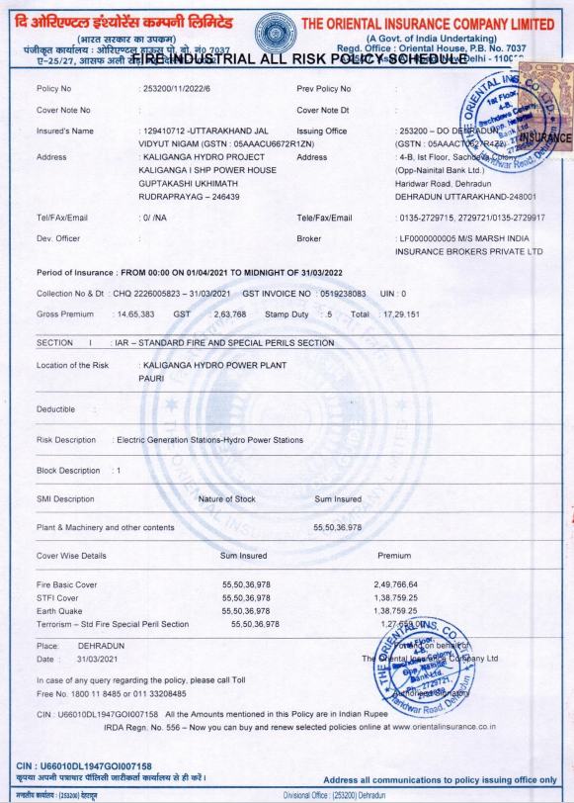
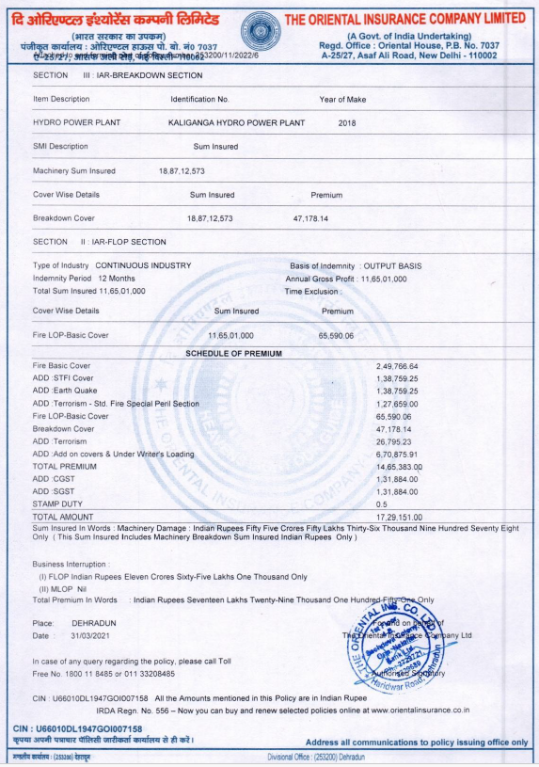
Sample Insurance Policy of Hydro Project in India (1/2)
ILLUSTRATIVE. FOR REFERENCE ONLY

Slide 17
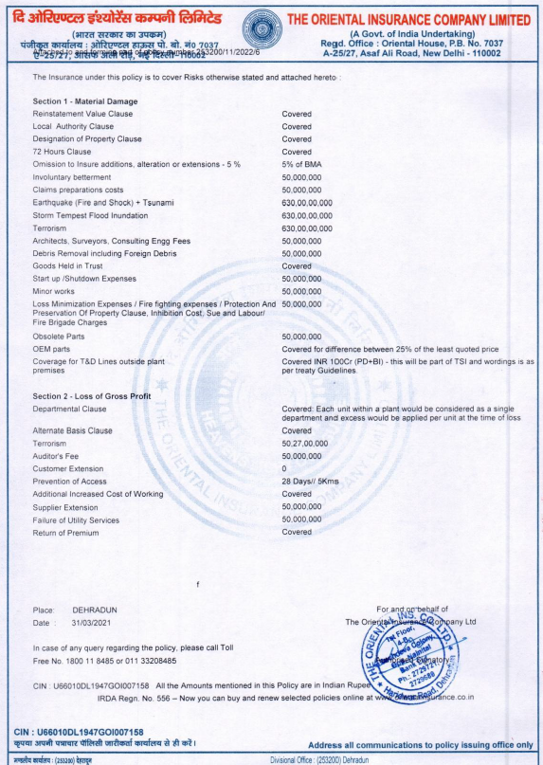
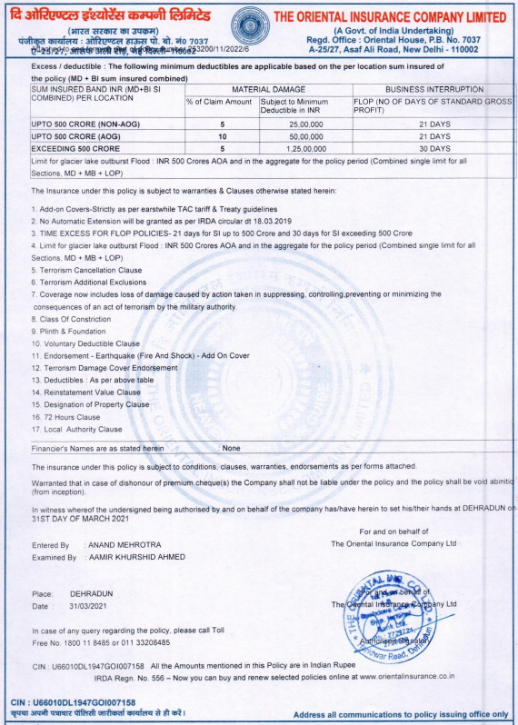
Sample Insurance Policy of Hydro Project in India (2/2)
ILLUSTRATIVE. FOR REFERENCE ONLY

Slide 18




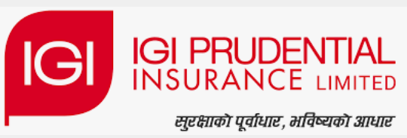






Some Major Players in Hydro Insurance Market in South Asia
Some key players listed which offer non-life insurance products that can cater to Hydro power projects
Major Players in India
Major Players in Nepal
Major Players in Bhutan
Insurance Regulatory and Development Authority of India(IRDAI)
Nepal Insurance Authority (NIA)
Royal Monetary Authority of Bhutan (RMA)
Governing Body
Major Insurance Companies

Slide 19

Key features for selecting Insurance Agency
There are some critical parameters prima facie which should govern selection of insurance agencies for infrastructure projects
Gross Direct Premium: Indicates financial health and revenue generation of the insurer
Claim Settlement Ratio: This reflects the percentage of claims settled by the insurer against the total number of claims received.
Combined Ratio:
The combined ratio is a measure of an insurer's overall profitability.
Number of Mega Policies: Monitoring the number of mega policies can provide insights into the insurer's ability to attract and retain large clients.
Solvency Ratio:
This ratio measures an insurer's ability to meet its long-term obligations, particularly claims.
Turnaround Time:
This refers to the time taken by an insurer to process and settle claims.
Incurred Claim Ratio:
This ratio indicates the proportion of premiums that an insurer pays out as claims.

Slide 20
Case Study: NEEPCO Kameng HEP Meeting with Insurance Companies
Apprehensions highlighted in pre-bid meeting by Insurance/ Reinsurance players
NEEPCO conducted a pre-bid meeting with United India Insurance Co. Ltd. (UIIC) and its Re-insurer, New India Insurance Co.Ltd and National Insurance for having an insurance policy for Kameng HP Plant (600 MW) on 26th April, 2021. The following challenges were discussed in the meeting:
Due to huge losses suffered in some Hydro Power plants, Re­ Insurers (RI) have become apprehensive and considerable Securities offering insurance policies are stated to have exited the market. One example of the huge losses is stated to have been suffered in Columbia.
1
Any possibility of landslide, rockslide in the penstock alignment of the Kameng HE Plant was inquired by the Reinsurer, where NEEPCO stated that adequate precaution has been taken in design.
2
The reinsurer also inquired about any possibility of flood in Power House from tail pool water. NEEPCO stated that the Power House has been designed to withstand PMF value of 18844 Gurnee approved by Central Water Commission.
3
Swiss Re the Re-insurer inquired if there was any recent flood in the Project. NEEPCO stated that Bichom Dam and Tenga Dam are designed to save from any such unlikely circumstances.
4
There was also enquiry about existence of any Early Warning System (EWS) in the project to get adequate information about Glacial Lake Outburst Flood (GLOF). NEEPCO stated that there is no possibility of GLOF in the project as the relevant catchment areas largely fall below the snow line
5

Slide 21
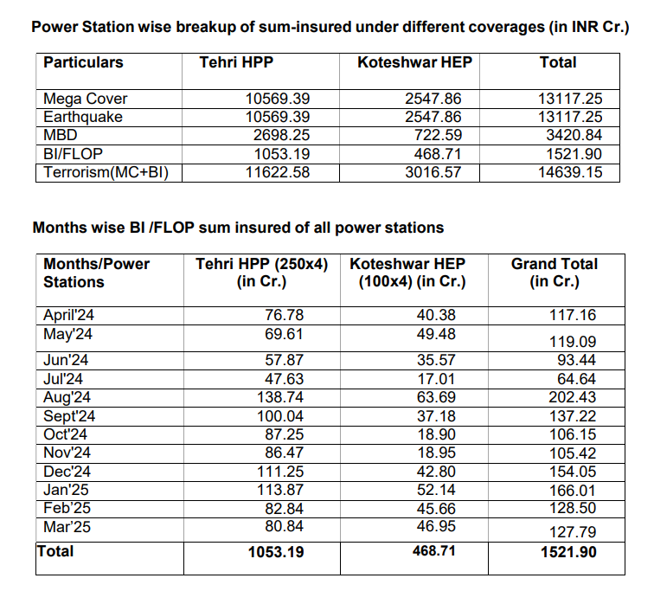
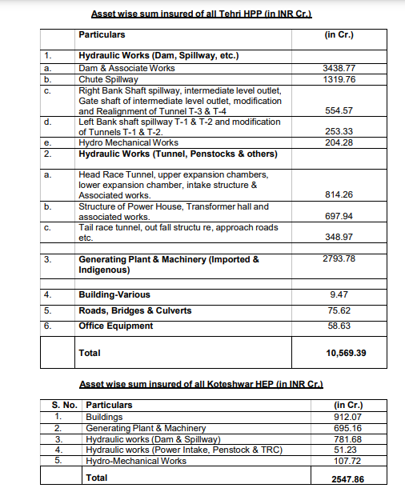
THDC Hydro Power Plants- Sum Insured Coverage Details
Sum insured covered by power plants through different heads of coverage to ensure the maximum benefits
Back

Slide 22
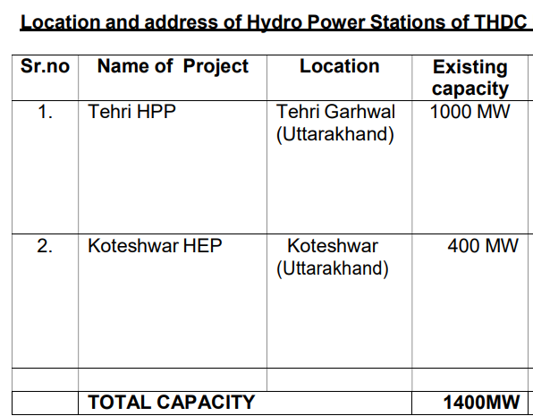
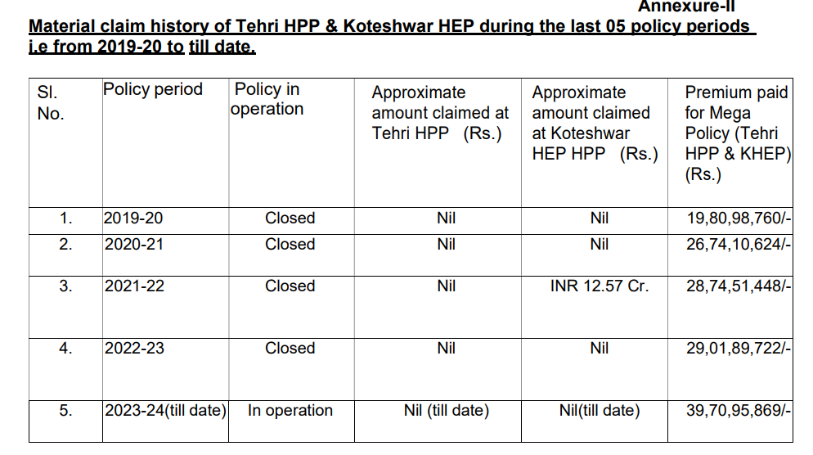
THDC Hydro Power Plants Insurance Premium Highlights
THDC adopt Mega insurance policy for its hydro power plants and the premium paid trend shows that in past five years the premium has been two folds from FY20 to FY24, i.e from Rs. 1.42 lakh/ MW to Rs. 2.82 Lakh/MW
Back

Slide 23
Types of Insurance for Hydro Power Projects during Construction Phase (1/4)
Different Insurance options available depending on phase of project life
Contractor’s All Risk (CAR) Insurance
Coverage Scope:
CAR Insurance primarily covers risks associated with civil engineering works.
It protects against damage to insured property due to sudden, accidental, and unforeseen causes.
Liability coverage extends to third-party claims for injury, death, or damage to third-party property.
Covered Risks:
Losses arising from Normal risks such as Fire, Lightning, Burglary, and Housebreaking are included.
Act of God risks like Earthquake, Flood, Inundation, Landslide, Subsidence, Rockslide, Storm, Typhoon, and Hurricane are covered.
CAR policy can be extended to include risks from Riot, Strike Damage, Malicious Damage, and Terrorism.
Duration of Cover:
The policy covers the duration from the commencement of work or after the unloading of the first lot of materials at the site, whichever is earlier.
The cover extends until the date specified in the policy schedule or the date of handing over the completed works to the principal, whichever is earlier.
Sum Insured Calculation:
The sum insured for CAR insurance is computed based on the completed project value, including Freight and Customs duty.
Escalation costs can be added to the sum insured based on the contract requirements between the contractor and the employer.
Back

Slide 24
Types of Insurance for Hydro Power Projects during Construction Phase (2/4)
Different Insurance options available depending on phase of project life
Erection All risk Insurance
Coverage Scope:
EAR Insurance covers material damage and third-party liability during the erection and installation of Plant and Machinery.
Similar to CAR insurance, EAR is a named exclusion policy, which implies it covers all insurance risks except those explicitly mentioned in the exclusion section of the policy.
Policy Purchase:
EAR Insurance should be purchased specifically during the installation of Turbines, Generators, and other electromechanical equipment of Hydropower projects.
Contractor’s Plant and Machinery (CPM) Insurance
Coverage Scope:
CPM Insurance covers the risk associated with the plant and machinery of a contractor used in hydropower construction at specified work sites.
Contractor's machinery is often subjected to rough conditions, making it more vulnerable to damage.
Policy Purpose:
CPM Policy is designed to protect the insured against sudden and unforeseen physical loss or damage to the plant and machinery.
Covered Equipment:
The policy covers various types of construction equipment including compressors, heavy-duty cranes, boring machines, bulldozers, pipe jacking, hauling equipment, excavators, loaders, etc
Back

Slide 25
Types of Insurance for Hydro Power Projects during Construction Phase (3/4)
Different Insurance options available depending on phase of project life
Transit Insurance
Coverage Scope:
Transit Insurance covers raw materials or finished goods during transportation from the place of loading to the destination.
It applies to various transportation modes including air, sea, or road.
Covered Risks:
The insurance policy covers damage or loss of goods while in transit due to mishandling, accidents, explosions, impact fires, theft, malicious damage, strikes, riots, and civil commotion.
Additional Coverage:
Transit insurance also covers related expenses such as incidental costs, tolerance costs, and duty costs.
Premium Determinants:
The premium for transit insurance depends on factors such as the type of goods, mode of transport, and the level of risks required by the insured.
Professional Indemnity (PI) Insurance
Coverage Scope:
PI Insurance covers claims for legal liabilities owed to a third party, typically a client of the insured.
It protects against losses suffered by the third party arising from the insured providing professional services.
Back

Slide 26
Types of Insurance for Hydro Power Projects during Construction Phase (4/4)
Different Insurance options available depending on phase of project life
Professional Indemnity (PI) Insurance
(Contd…)
Liability Causes:
Liability under PI Insurance can result from unintentional breach of privacy or confidentiality, omission of information, making errors of judgment, or providing incorrect advice.
Legal Cost Coverage:
PI Insurance can cover legal costs associated with defending claims made against the insured.
Back

Slide 27
Types of Insurance for Hydro Power Projects during Operational Phase (1/2)
Different Insurance options available depending on phase of project life
Fire and Allied Perils Insurance
Coverage Scope:
Hydropower Project Insurance protects the project and its components from various risks including fire, lightning, earthquake, flood, inundation, landslide/rockslide, storm, typhoon, hurricane, explosion, aircraft damage, etc.
Named Risk Policy:
It operates as a named risk policy, meaning only the risks for which the insured pays a premium will be covered.
Risks not mentioned in the policy are not covered. For instance, if a tunnel is not insured against flood risk and it sustains flood damage, it won't be covered.
Additional Coverage:
Risks such as Riot, Strike Damage, Malicious Damage, Sabotage, and Terrorism risk can be added to the policy by paying extra premiums.
Regulatory Guidance:
In Nepal, the policy is guided by the Fire Tariff issued by the regulatory board Beema Samiti.
Premium rates, conditions, and exclusions are determined as per the fire tariff and are standardized across insurance companies.
Customizable Coverage:
Clients can choose which components should be insured against specific risks based on the nature and location of the components.
For example, headworks parts may not be insured against fire risks, but electromechanical parts are typically insured
Back

Slide 28
Types of Insurance for Hydro Power Projects during Operational Phase (2/2)
Different Insurance options available depending on phase of project life
Business Interruption Insurance
(Loss of Profit Insurance)
Policy Nature:
Business Interruption Insurance is not a stand-alone policy but is sold as an addition to the Fire insurance policy.
Coverage Scope:
It covers the loss of income that a hydropower project suffers after the disaster stated in the Fire insurance policy.
Loss of revenue due to damage to hydropower components by insured risks mentioned in the fire policy is covered.
Deductible and Limit:
Like other policies, it includes deductible excess and a limit of indemnity stated in the policy.
Non-tariff Based:
Business Interruption Insurance is a non-tariff based insurance policy
Machinery Breakdown Insurance
Coverage Scope:
Machinery Breakdown (MB) Insurance covers the sudden and unforeseen physical loss of or damage to electro-mechanical equipment such as turbines and generators in a hydropower plant, necessitating their repair or replacement.
Sum Insured Calculation:
The sum insured for MB insurance should be the cost of replacing the insured machine with a new machine of the same kind at the same location.
Additionally, custom duty, transportation, and installation charges can be added to determine the sum insured.
Back

Slide 29
Case Study 1: Tender Analysis of Mega Risk Insurance/Large Risk Insurance policies Purchase by THDC India Limited
Project Details: Tehri HPP Stage-I (4x250 MW) & Koteshwar HEP (4X100 MW).
General Tender Terms:
Experience in insurance coverage of HEP with a capacity of min 30 MW
Experience with an international re-insurer rated "A+" or a national reinsurer rated "BB+" by international rating agencies
Liquid capital of the bidder not be less than Rs. 100 Cr.
Solvency Ratio at least 1.5
Average claim settlement ratio to be above 50% over the last three years
Retention power to not be less than Rs. 500 Crores
Total sum insured is for protection against Fire, Earthquake, Machinery Breakdown (MBD), Fire Loss of Profit (FLOP), & Terrorism
Addition of new power stations during the policy period to be covered with additional premium payment
Shifting of the equipment's from existing location after dismantling and re- erection, re-testing and commissioning at any other location and vice versa within the premises of power Station shall also be covered in this policy
Source: THDCIL Tender No: THDCIL/NCR/CC-471
Back

Slide 30
Case Study 2: Tender Analysis of IAR Insurance policies Purchase by Himachal Pradesh Corporation Limited (HPCL)
Project Details: HPCL 406 MW Hydro Electric Plants (Sainj, Kashang & Swara Kuddu)
Major Full Coverage Add On:
Earthquake, Storm,
Flood, Tempest & Inundation,
Transmission & Distribution Lines (Up to 100 Cr MD +BI)
General Tender Terms:
Participants to be Indian Nationalized Insurance only
Section I: Material Damage (All Risk including Machinery Breakdown)
Covers all risks, including machinery breakdown, related to physical damage to insured property.
Section II: Business Interruption (All Risk including Machinery Breakdown)
Covers loss of gross profit during the indemnity period due to business interruption following damage or loss to insured property.
Includes increased costs of working incurred due to the interruption.
Back
Source: HPPCL NIT dated 30/01/2023

Slide 31
Some Key Observations with respect to Insurance for Power Sector projects
Major reforms introduced in Re-Insurance Market in India
NTPC typically secures a Mega Insurance policy covering aspects such as terrorism, force majeure, equipment damage, fire protection, and earthquakes for all its thermal power plants collectively.
National Thermal Power Corporation (NTPC)
For RE Projects, NREL is presently insuring existing projects under a similar Mega Insurance package but going forward would execute insurance for individual project separately. At present loss of generation profit is not being insured as the premium gets disproportionately high.
National Renewable Energy Laboratory
(NREL)
Insurance expenses impact EBIDTA, necessitating it to be optimized to enhance EBIDTA margins, specifically so when organization are looking for good market multiples to ensure healthy investments in projects.
Impact on EBIDTA
Strategic Insurance Planning
Detailed analysis of potential threats and cost implications of the insurance coverage thereof to hedge the risks, is extremely necessary to build a robust business model.
Back

Slide 32
Case Study: UERC allows passthrough of Insurance premium at actuals
Passthrough of Insurance Premium allowed at actuals for calculation of normative O&M for 9 LHPs of UJVN in FY 22 True Up
Uttarakhand Jal Vidyut Nigam Ltd (UJVN) Tariff Order issued by Uttarakhand Electricity Regulatory Commission (UERC) dated 30th March 2023
With regard to the insurance expenses, the Commission in the MYT Order dated February 27, 2019, observed as follows:
“…The Commission observed that the A&G expenses have increased significantly in the immediately preceding years partly on account of the increase in insurance expenses. In view of the above, as discussed in Chapter 4, the Commission has decided to treat insurance expense as uncontrollable in nature.
….
In addition to the above, the Commission shall allow to recover actual Petition filing fees and insurance charges subject to prudence check at the time of truing up”
Further, with respect to FY 2021-22 True Up, the Commission stated the following:
“The normative A&G expenses for FY 2021-22 have been arrived by escalating the normative A&G expenses for FY 2020-21 with the revised WPI escalation rate of 2.42% after excluding Petition filing fees, actual insurance expenses paid and normative security expenses in FY 2021-22, and thereafter, adding the actual insurance expenses, security expenses, ERP expenses and Petition filing fees incurred in FY 2021-22.”
Source: UERC
Back

Slide 33
Introduction of IRDAI (Reinsurance) (Amendment) Regulations 2023
Major reforms introduced in Re-Insurance Market in India
Reinsurers handle complex risks, including those from natural disasters or major events, using their expertise in global risk distribution and continuous innovation. However, barriers to cross-border reinsurance weaken local markets, limiting access to global capacity and expertise.
Barrier risk financial instability during disasters, leaving losses uninsured or disproportionately impacting domestic insurers and reinsurers
New exemptions allowing up to 20% of total retroceded business by Indian reinsurers to count towards minimum retention requirement.
Introduction of IRDAI (Reinsurance) (Amendment) Regulations 2023 to harmonize regulations for Indian insurers, Indian reinsurers, foreign reinsurance branches (FRBs), and IFSC Insurance Offices (IIOs)
Procedural ease, with Indian insurers only needing to submit soft copies of reinsurer lists and final reinsurance programs.
Proposed regulations consolidate FRBs and Lloyd's India, streamline compliance, promote mergers, and boost reinsurer presence for expanded capacity and efficient coverage availability
Changes aim to create a competitive reinsurance landscape, ensuring equal participation of IFSC Insurance Offices (IIOs) with FRBs
Back

Slide 34
Regulatory treatment of Insurance with respect to Electricity Act 2003
Different approaches to insurance while determination of tariff u/s 62 and 63 of EA 2003
Electricity Act, Section 62 (Tariff Determination under Cost plus method)
Section 62 of the Electricity Act serves as “Pseudo” insurance for the power sector, covering various project aspects. However, there is no separate clause for reimbursement of insurance expenses; it must be managed within approved limits of O&M expenses
Case-in-Point:
Stage - 1
Stage - II
Stage - III
Stage - IV
Penstock of Kopili HEP got burst
Insurance Cost claimed by NEEPCO
Partly Reimbursed
Balance portion claimed as reimbursement through tariff for Capex incurred in recommissioning the project
Electricity Act, Section 63 (Tariff Determination through Competitive Bidding)
Under Section 63 of the Electricity Act, insurance costs are not pass through and thus requires all projections for premium before the bid itself, to be done correctly, for the project economics to work. With majority of the projects being operational beyond the initial operational life, the carrying cost of asset & the insurance there of becomes a debatable proposition post completion of scheduled operational life.
Back

